Slide 1
FORMATION OF PROTON BEAMS IN NICA COLLIDER
E. Syresin, O.Kozlov, N. Mityanina, I.Meshkov, A. Sidorin
REPORT CONTENTS
Luminosity of colliding protons beams
Proton injection from Nuclotron to Collider
Cooling of proton beam
Storage of proton beams at low energy 2-2,5 GeV
Space charge effects and parameters of RF1 barriers
Acceleration by RF1 barriers
Longitudinal instability
Crossing critical energy
Bunching of proton beams at energy of experiments

Slide 2
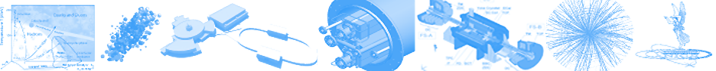
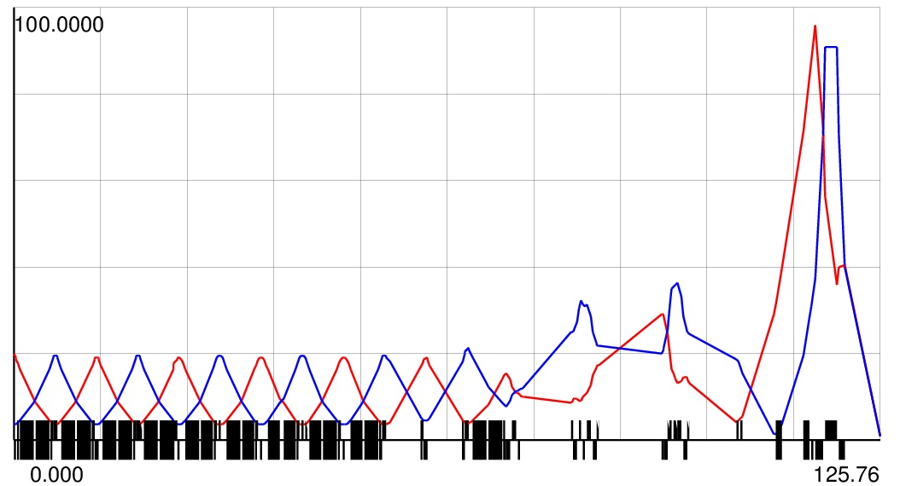
beam1=beam2 (pp)
Optics
β –function,
β*=0.7m
For equal beams (pp): E_{k,beam1}=E_{k,beam2}, (Bρ)_{beam1}=(Bρ)_{beam2}
Common elements: BV₁ B₁=B₂, QFF(1-3) K_{QFF,1}=K_{QFF,2}
O.Kozlov simulations

Slide 3


Proton-Proton Mode: 2 IP, but (!) Luminosity for 1 IP
SPD only!
Luminosity for 1 IP and
N_{p} is proton number per bunch
ΔQ_{1 = 0.05}
ΔQ₂ = Δq + ξ = 0.05
ε = 1.1 π*mm*mrad
PROJECT LUMINOSITY
Bunch intensity N_{b}=10¹²
Proton intensity in ring N=2.2×10¹³
L=10³²cm⁻²s⁻¹
Igor Meshkov Optimum Luminosity of Proton-Ion Collider, PEPAN v.50,#6,2019 (in print)

Slide 4
LUMINOSITY OF COLLIDING PROTON BEAMS
I.N. Meshkov simulations at ΔQ+ξ=0,05, ε=1,1π⋅mm⋅mrad
with one IP,
in second IP both colliding beams are deflected by horisontal correctors
L=5×10³²cm⁻²s⁻¹
Bunch intensity N_{b}=2×10¹²

Slide 5
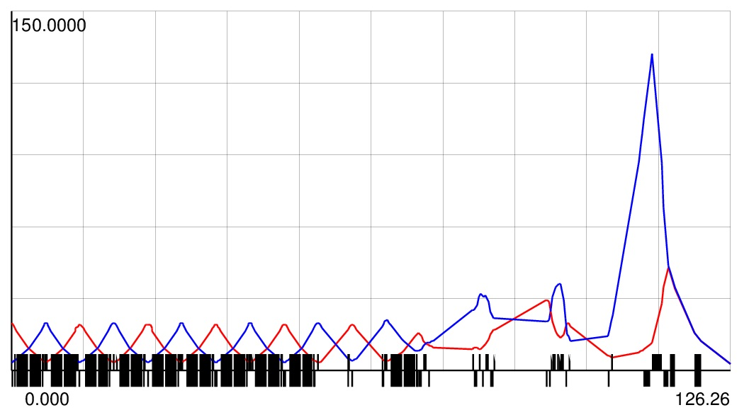
beam1≠beam2 (pD)
Optics
β –function,
β*=3m
For (pD) beams: E_{k,p}=E_{k,D} per amu (v₁=v₂), (Bρ)_{D}=2(Bρ)_{p}
Common elements: BV₁
Separarte elements: BV_{2,} QFF-quadrupoles
Additional Vert.dipole corrector for p (or D) beam in [BV₁-BV₂]
O. Kozlov proposal and simulations

Slide 6
Deuteron-Proton Mode: 2 IP, but (!) Luminosity for 1 IP
Luminosity for 1 IP and
N_{d} and N_{p} are particle number per bunch
β –function,
β*=3m
ΔQ_{1 = 0.05}
ΔQ₂ = Δq + ξ = 0.05
ε = 1.1 π*mm*mrad
I.N. Meshkov simulations

Slide 7
PROTON INJECTION FROM NUCLOTRON TO COLLIDER
Proton intensity in collider ring
N=2×10¹³
Proton bunch intensity at Nuclotron injection in collider
N=5×10¹⁰
Proton repetition frequency at Nuclotron injection in two collider rings at kinetic energy 2-5 GeV (B=0.4-1T, dB/dt=0.8T/s, t=1 sec- time between end of one cycle and start of new cycle )
f=0.5-0.3 Hz
Time, required for Collider proton injection at kinetic energy 2 GeV
T_{inj}=1600 sec
Normalized rms longitudinal emittance
γβσ_{s} σ_{p} =2×10⁻² m
Normalized rms transverse emittance
γβε =4 π×mm×mrad
E_{k}, GeV | 1 | 3 | 4.5
ε_{long}=σ_{s}σ_{p}, m | 1,2×10⁻² | 5×10⁻³ | 3.6×10⁻³
σ_{s}, m | 10 | 10 | 10
σ_{p} | 1,2×10⁻³ | 5×10⁻⁴ | 3.6×10⁻⁴
ε, π×mm×mrad | 2.4 | 1 | 0,7
B, T | 0,24 | 0,6 | 0,85

Slide 8
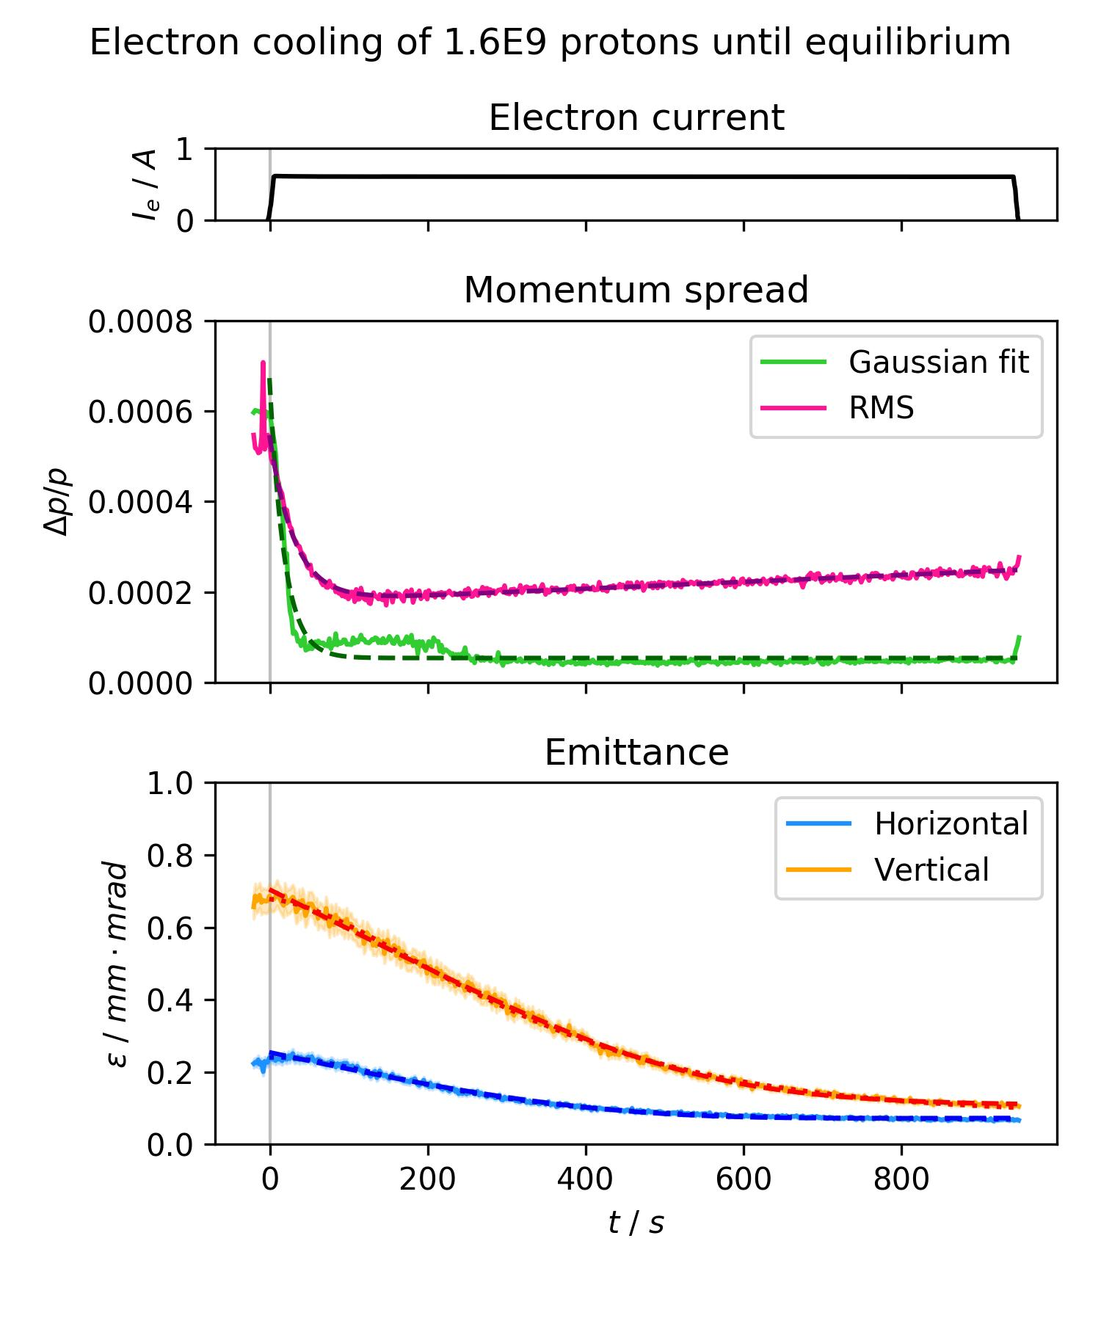
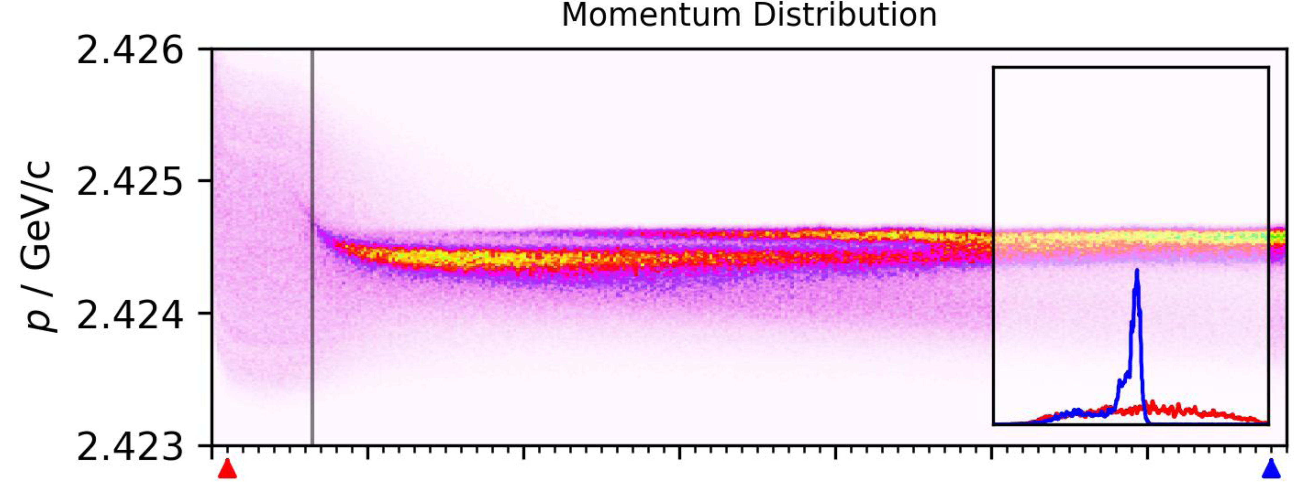
ELECTRON COOLING OF PROTON BEAMS AT COSY
COSY experiment
γ=2.78, Ek=1.66 GeV, Ee=907 MeV,
Longitudinal cooling time
τ_{cool}=18,6 s
Transverse cooling time
τ_{cool-h}=132 s
τ_{cool-v}=182 s
I=0,62 A

Slide 9
ELECTRON COOLING OF PROTON BEAMS
Application of electron cooling with time about τ_{cool}=100 s by one order shorter than storage ion time T_{inj}= 1600s permits to form dense proton beam with small emittance and large betatron tune shift of ΔQ=0,05.
Reduction by 30 times at longitudinal cooling of normalized rms longitudinal emittance
N_{inj}γβσ_{s}σ_{p} =8 m for 400 bunches injected from Nuclotron
N_{b}γβσ_{s}σ_{p}=0,26 m for 22 bunches at NICA experiments
Longitudinal cooling at storage of proton beam is required
Dependence of cooling time on kinetic proton energy

Slide 10
FORMATION OF HIGH DENSITY COOLED PROTON BEAM AT LOW ENERGY
Proton intensity in collider ring
N=2×10¹³
Kinetic proton energy
E=2 GeV
Laslet tune shift
ΔQ=0,05
Stored stack, occupied half of Collider ring, has rms emittance
ε=r_{p}N/(2πΔQγ³β²)=4,8 π×mm×mrad
After acceleration up to proton kinetic energy 12 GeV rms emittance is reduced to ε= 1.1 π×mm×mrad
Application of electron cooling with time about τ_{cool}=100 s by one order shorter than storage ion time T_{inj}= 1600s permits to form dense proton beam with small emittance and large betatron tune shift of ΔQ=0,05.

Slide 11
RF1 BARRIER PARAMETRS
Maximal voltage – 5 kV
Four rectangular barriers per turn with phase length- π/12
Stack phase zone– π (Nuclotron perimeter 251.5 м).
Kicker fronts – 2 x 200 ns = 0.54π
Kicker plato -200 ns=0.27 π
Injection zone = kicker frons + kicker plato=0.54 π=204 m
-π/2
π+Δ
0
π/2
Rf1₂
kick
Nuclotron
ϕ
At acceleration stack occupies half of ring
ВМ
kik
Rf1₁
Synchronization of stack formation in two
Collider rings permits to avoid parasitic stack collisions

Slide 12
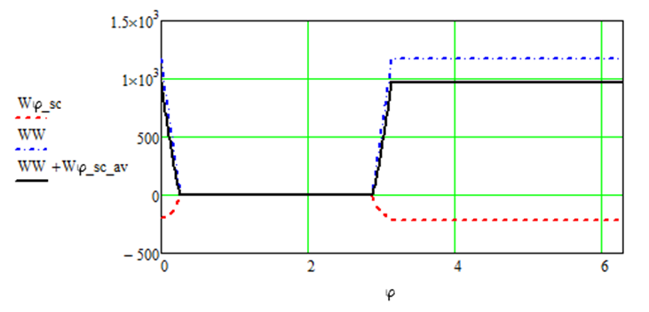
PROTON STACK SPACE CHARGE EFFECTS AT RF1 BARRIER BUCKET STOREGE
RF1 voltage at heavy ion operation U=5 kV,
Phase width ϕ=π/12
Current of Au⁷⁹ ions I=0,4 A, N_{i}=5.2×10¹⁰, Z=79
W_{sp}/W_{RF}=1,2I/γ²β
Space charge effects of Au⁷⁹ ions gives a reduction of 5,5% of RF1 barrier bucket capacity
Current of protons I=1.87 A, N_{p}=2×10¹³
Space charge effects of protons by 4.5 times larger than Au⁷⁹ions
Space charge effects of Au⁷⁹ gives a reduction of 26% of RF1 barrier bucket capacity V×Δϕ and 13% reduction of maximal proton momentum spread
RF barrier bucket and space charge potential distribution
Exiting RF1 system can be used for storage of proton beam with current 1,87 A at proton energy of 2 GeV.

Slide 13
INDUCTION ACCELERATION BY RF1 BARRIERS
At proton energy close to critical energy E_{cr}=6 GeV, the RF barriers switch off. Protons pass through the critical energy without RF barriers. When proton energy becomes larger critical energy RF1 barriers turn on again with opposite polarities.
At energy close to critical momentum compaction factor is equal to η≅ 2Δγ/γ³ ≅ 3×10⁻⁴ at Δγ=0.05.
To accelerate protons to this energy the required time is of 0.25 s.
Quadrupole power supply that creates current difference between F and D lenses will be used for fast variation of dispersion to provide a jump of critical gamma on a value Δγ_{cr} =-0.1 during T_{jump}= 15 ms
Δγ_{cr} =1.8×ΔQ, ΔQ ≅ 0.05 at Δγ_{cr} =0.1,
α=1/γ_{cr}²=∫D_{x}/ρds/C, Δα==-ΔKl/G×(D_{x}²-D_{y}²) =5.8×10⁻⁴
ΔK=0.095m⁻¹
ΔQ=βΔKl/4π=0.071
ΔK produced by 24 lenses at ΔI=75 A. Maximum available dI/dt=5kA/s, provides T_{jump}=15 ms, L_{Q}=2.3 mGn, V=11.5 V
Induction acceleration of stack ions fulfilled half of ring by RF1 voltage U=300 V.
Required time for proton acceleration
τ_{ac}=T_{rev}(γ_{exp}-γ_{inj}) mc²/eU=50 s.
Amplitude of RF barriers is reduced at proton acceleration
Δp/p∝(V_{RF} /γη)^{1/2}
Momentum spread and beam emittance at proton acceleration are reduced as
Δp/p∝1/γ, ε∝1/γ.
The spreading of stack T_{st}=0.85 µs at transition through γ_{cr} with out RF1 barriers is equal to ΔТ=Т_{jump} η(Δp/p) ≅2 ns at Δp/p=2×10⁻⁴.

Slide 14
LONGITUDINAL INSTABILITY
Threshold current of longitudinal instability
I=4mc²β²γησ_{p-th}²/eZ
At energy 2 GeV, I=1,87 A rms momentum spread of coasting beam σ_{p-th}=4 ×10⁻⁴
At transition to critical energy threshold of momentum spread is increased
σ_{p-th} ∝1/η^{1/2}
At proton acceleration during time τ total relative momentum variation is about
(δp/p)²=(Δp/p)²+(eU/γmc²×τ/T_{rev})²
Time τ corresponds to development of longitudinal instability
τ=T_{rev(}Δp/p)γβ²×4mc²/eIZ
σ_{p-th}< eU/γmc²×τ/T_{rev}
Δp/p∝1/γ
τ=190 ms, E≈6 GeV, Δp/p=1.8×10⁻⁴
eU/γmc²×τ/T_{rev}=5.7×10⁻³.
Proton stack is stable at realization of jump of γ_{tr}.

Slide 15
BUNCHING OF PROTON BEAM
After acceleration from 3 GeV up to proton kinetic energy 12 GeV rms emittance from ε= 4.8 π×mm×mrad reduces to ε = 1.1 π×mm×mrad
2. Reduction of Laslett tune shift at acceleration up to 12 GeV by 18 times ΔQ ∝ 1/(γ³ε) ∝1/γ²
3. At formation of full coasting beam at energy 12 GeV further 2 times reduction of Laslett tune shift
4. After acceleration up to energy 12 GeV threshold momentum spread of coasting beam corresponds to
σ_{p-th}=1.4×10⁻⁴
at impedance, defined by proton beam space-charge.
5. RF2 and RF3 provide bunching up to rms bunch length of σ_{s}= 60cm.
6. Rms momentum spread after bunching is increased up to
Δp/p = σ_{p-th}×C/(N2(3)^{1/2}σ_{s}) = 1,5×10⁻³
Longitudinal normalized rms emittance of bunched beam is required of
Nγβσ_{s}σ_{p} = 0.26 m
It is by 30 times less then longitudinal emittance of 400 times injected Nuclotron beam in Collider at storage
Cooling is obligatory!!
7. Again increase of Laslett tune shift by 15 times at beam bunching ΔQ ∝ C/(N(2π)^{1/2}σ) up to level of ΔQ = 0,021.
8.Luminosity of proton-proton colliding beams is
L=10³²cm⁻²s⁻¹ .

Slide 16
THANKS FOR YOUR ATTENTION

